Slide 1




Name- Krishna Kant Dubey

Slide 2

Introduction to AI

Slide 3
Agenda
Introduction to AI concepts
Introduction to machine learning concepts

Slide 4
Introduction to AI concepts
Introduction to AI
Generative AI
Computer vision
Speech
Natural language processing
Extract data and insights
Responsible AI
Assessment

Slide 5
Introduction to AI
This module is designed to provide a high-level overview of some core capabilities of artificial intelligence (AI) and give you an intuition of how they work.
we won't be writing any code or getting into the mathematical details of machine learning models. Instead
we'll focus on understanding the kinds of things that AI can do, and the basic principles on which it is based

Slide 6
Generative AI
Generative AI is a branch of AI that enables software applications to generate new content; often natural language dialogs, but also images, video, code, and other formats.
The ability to generate content is based on a language model, which has been trained with huge volumes of data - often documents from the Internet or other public sources of information.
Generative AI models encapsulate semantic relationships between language elements (that's a fancy way of saying that the models "know" how words relate to one another), and that's what enables them to generate a meaningful sequence of text

Slide 7
Computer vision
Computer vision is accomplished by using large numbers of images to train a model.
Image classification is a form of computer vision in which a model is trained with images that are labeled with the main subject of the image (in other words, what it's an image of) so that it can analyze unlabeled images and predict the most appropriate label - identifying the subject of the image.
Object detection is a form of computer vision in which the model is trained to identify the location of specific objects in an image.

Slide 8
Speech
Speech recognition is the ability of AI to "hear" and interpret speech. Usually this capability takes the form of speech-to-text (where the audio signal for the speech is transcribed into text).
Speech synthesis is the ability of AI to vocalize words as spoken language. Usually this capability takes the form of text-to-speech in which information in text format is converted into an audible signal.
AI speech technology is evolving rapidly to handle challenges like ignoring background noise, detecting interruptions, and generating increasingly expressive and human-like voices

Slide 9
Natural language processing
Common NLP tasks include:
Entity extraction - identifying mentions of entities like people, places, organizations in a document
Text classification - assigning document to a specific category.
Sentiment analysis - determining whether a body of text is positive, negative, or neutral and inferring opinions.
Language detection - identifying the language in which text is written.

Slide 10
Extract data and insights
Key points to understand about using AI to extract data and insights include:
The basis for most document analysis solutions is a computer vision technology called optical character recognition (OCR).
While an OCR model can identify the location of text in an image, more advanced models can also interpret individual values in the document - and so extract specific fields.
While most data extraction models have historically focused on extracting fields from text-based forms, more advanced models that can extract information from audio recording, images, and videos are becoming more readily available.

Slide 11
Responsible AI
Fairness
Reliability and safety
Privacy and security
Inclusiveness
Transparency
Accountability

Slide 12
Introduction to machine learning concepts
What is machine learning?
Types of machine learning
Regression
Binary classification
Multiclass classification
Clustering
Deep learning
Transformers

Slide 13
What is machine learning?
Machine learning has its origins in statistics and mathematical modeling of data. The fundamental idea of machine learning is to use data from past observations to predict unknown outcomes or values. For example:
The proprietor of an ice cream store might use an app that combines historical sales and weather records to predict how many ice creams they're likely to sell on a given day, based on the weather forecast.
A doctor might use clinical data from past patients to run automated tests that predict whether a new patient is at risk from diabetes based on factors like weight, blood glucose level, and other measurements.

Slide 14
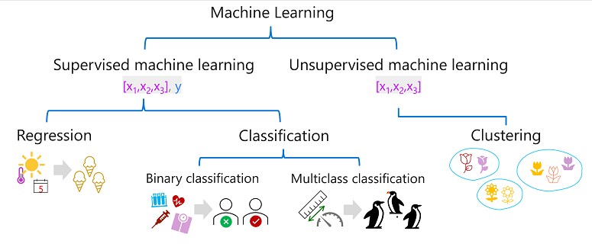
Types of machine learning

Slide 15
Regression
Regression is a form of supervised machine learning in which the label predicted by the model is a numeric value. For example:
The number of ice creams sold on a given day, based on the temperature, rainfall, and windspeed.
The selling price of a property based on its size in square feet, the number of bedrooms it contains, and socio-economic metrics for its location.
The fuel efficiency (in miles-per-gallon) of a car based on its engine size, weight, width, height, and length.

Slide 16
Binary classification
In binary classification, the label determines whether the observed item is (or isn't) an instance of a specific class. Or put another way, binary classification models predict one of two mutually exclusive outcomes. For example:
Whether a patient is at risk for diabetes based on clinical metrics like weight, age, blood glucose level, and so on.
Whether a bank customer will default on a loan based on income, credit history, age, and other factors.
Whether a mailing list customer will respond positively to a marketing offer based on demographic attributes and past purchases.

Slide 17
Multiclass classification
Multiclass classification extends binary classification to predict a label that represents one of multiple possible classes. For example,
The species of a penguin (Adelie, Gentoo, or Chinstrap) based on its physical measurements.
The genre of a movie (comedy, horror, romance, adventure, or science fiction) based on its cast, director, and budget.

Slide 18
Clustering
The most common form of unsupervised machine learning is clustering. A clustering algorithm identifies similarities between observations based on their features, and groups them into discrete clusters. For example:
Group similar flowers based on their size, number of leaves, and number of petals.
Identify groups of similar customers based on demographic attributes and purchasing behavior.

Slide 19
Thank You

